Slide 1
Unit 4
Deadlock

Slide 2
Deadlock
- Principles of deadlock, Deadlock Prevention, Deadlock Avoidance, Deadlock Detection, Deadlock Recovery

Slide 3

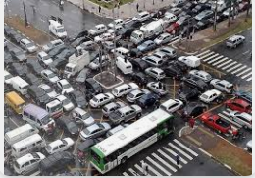
Deadlock
A process in OS uses different resources and uses resources in following way:
1) request a resource
2) use the resource
3) release the resource
resources can be files ,DB,IO devices etc
The process uses it and release on the completion.
A Deadlock is a situation where set of processes are blocked because each process is holding a resource and waiting for another resource acquired by other process .

Slide 4
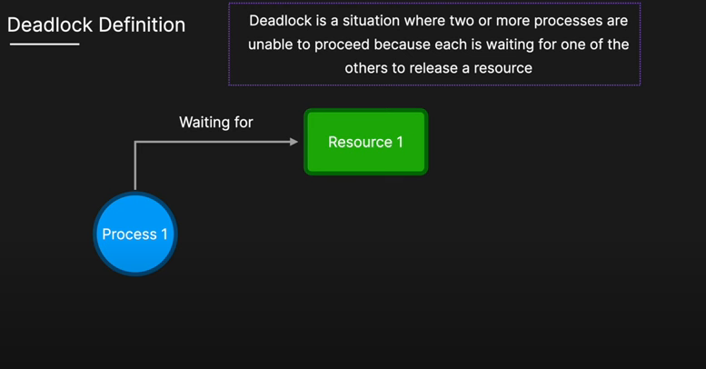

Slide 5
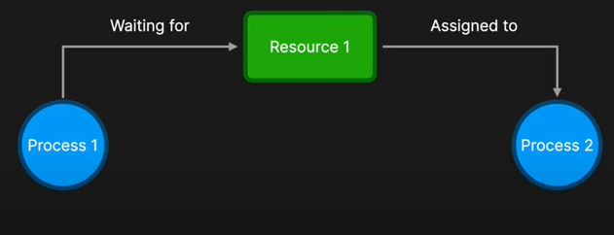

Slide 6
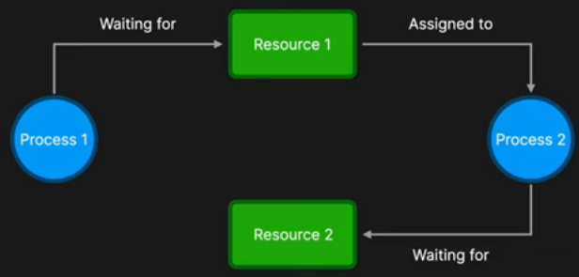

Slide 7
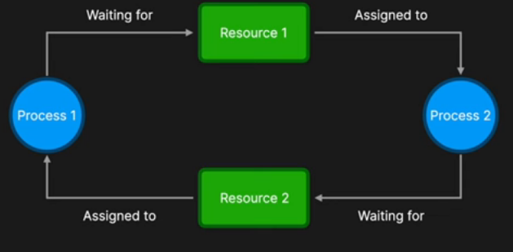

Slide 8
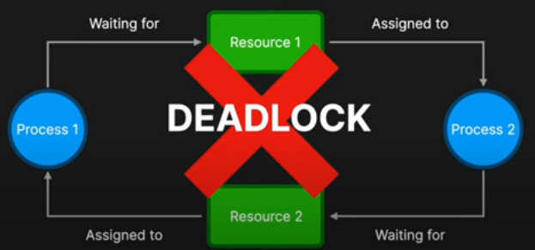

Slide 9
Difference between Starvation and Deadlock
Sr.No | Deadlock | Starvation
1 | Deadlock is a situation where process got blocked and no process proceeds | Starvation is a situation where the low priority process got blocked and the high priority processes proceed.
2 | Deadlock is an infinite waiting. | Starvation is a long waiting but not infinite.
3 | Every Deadlock is always a starvation. | Every starvation need not be deadlock.
4 | The requested resource is blocked by the other process. | The requested resource is continuously be used by the higher priority processes.
5 | Deadlock happens when Mutual exclusion, hold and wait, No preemption and circular wait occurs simultaneously. | It occurs due to the uncontrolled priority and resource management.

Slide 10
Deadlock Principles
Deadlock occurs when a group of processes are stuck in a waiting state, each waiting for a resource that another process holds, causing a cycle where none of the processes can proceed.
Necessary Conditions for Deadlock:
Mutual Exclusion: At least one resource must be held in a non-shareable mode.
Hold and Wait: Processes holding resources can request additional ones.
No Preemption: Resources cannot be forcibly taken away from a process.
Circular Wait: A set of processes are waiting for each other in a circular chain.

Slide 11
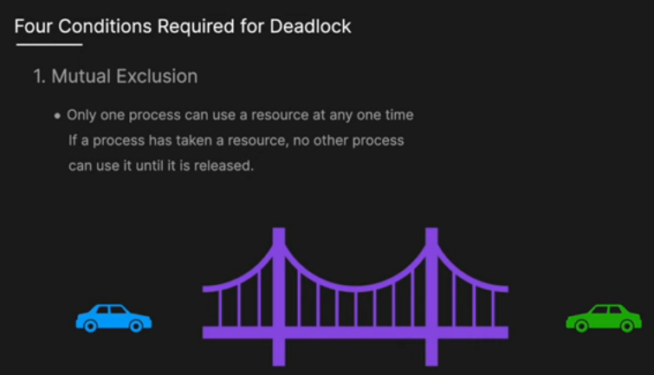

Slide 12
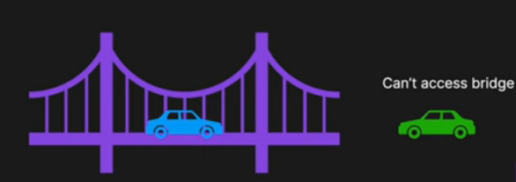

Slide 13
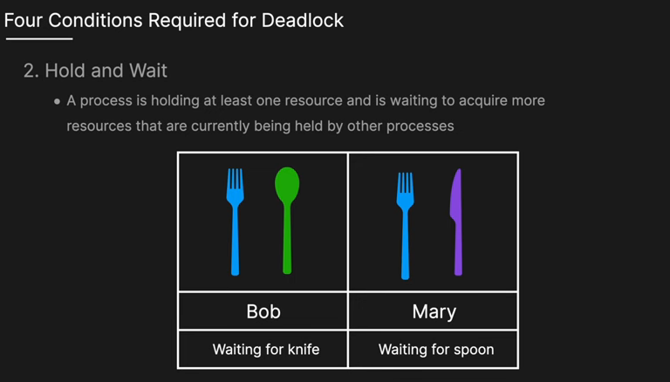

Slide 14
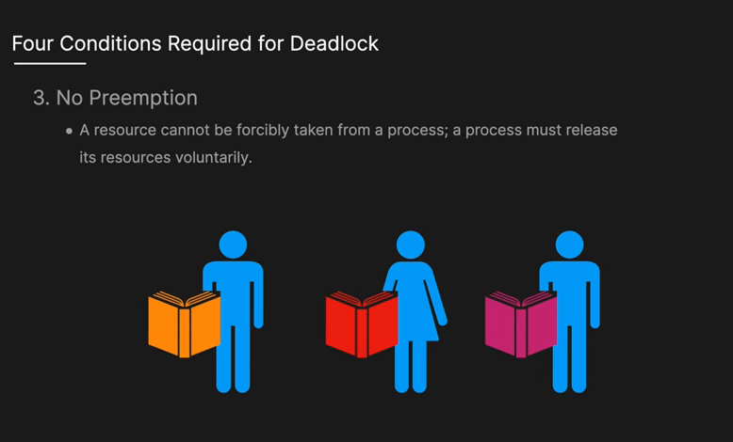

Slide 15
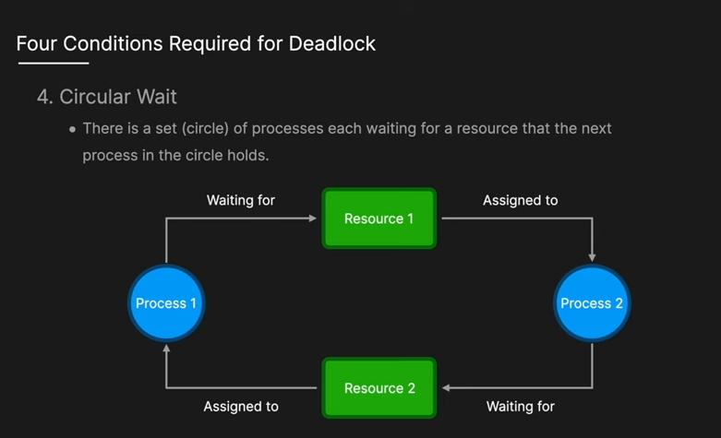
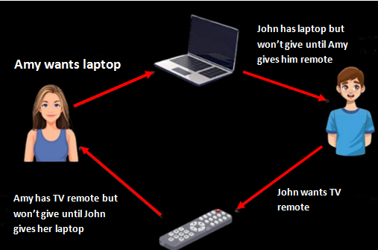

Slide 16
Strategies for handling Deadlock-
Deadlock Prevention
Deadlock Avoidance
Deadlock Detection
Deadlock Recovery

Slide 17
Deadlock prevention
Deadlock happens only when Mutual Exclusion, hold and wait, No preemption and circular wait holds simultaneously.
If it is possible to violate one of the four conditions at any time then the deadlock can never occur in the system.

Slide 18
1. Deadlock prevention
To prevent deadlock, at least one of the four necessary conditions must be negated:
Mutual Exclusion: Make resources shareable (if possible). This isn't always applicable, e.g., printers cannot be shared simultaneously. But File can be shared. (multiple processes can read the same file).
Hold and Wait: To prevent deadlock, make sure that each process asks for all the resources it needs at the very beginning. If the process gets everything, it can start working. If not, it waits until everything is available.

Slide 19
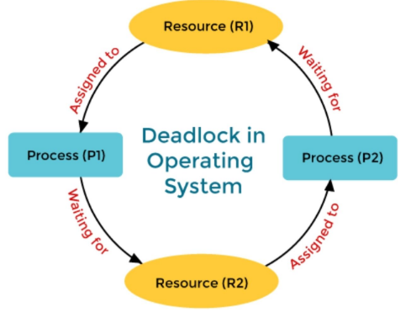
Deadlock prevention
Circular Wait: To prevent this, you can give resources an order or number. Every process must request resources in that order.
P1 having R1 and request for R2 ----P1 → 1 2 i.e in order
P2 having R2 and request for R1 ----P2 → 2 1 i.e not in order so request wont be granted. So deadlock will not happened
Circular Wait

Slide 20
Resource Allocation Graph
The resource allocation graph is the pictorial representation of the state of a system.
the RAG is the complete information about all the processes which are holding some resources or waiting for some resources.
contains the information about all the instances of all the resources whether they are available or being used by the processes.

Slide 21
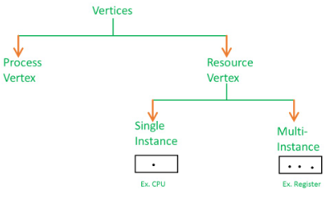
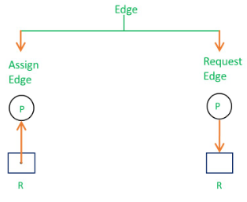
Resource Allocation Graph
In RAG, the process is represented by a Circle while the Resource is represented by a rectangle. G(V,E)—directed Graph
P

Slide 22
Resource Allocation Graph
Resource allocation graph
Cycle
NO Cycle
No deadlock
Multiple instance
Single instance
Deadlock
Deadlock may /may not happen

Slide 23
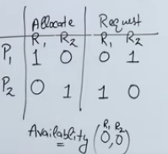
Example 1 (Single instances RAG)
For example, if process P1 holds resource R1,
process P2 holds resource R2 and
process P1 is waiting for R2 and
process P2 is waiting for R1,
then process P1 and process P2 will be in deadlock.

Slide 24
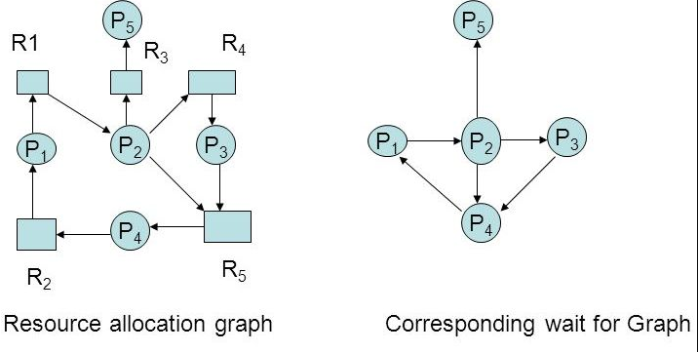
Wait for Graph
Extended Detection:
Wait-For Graph (WFG): To simplify detection, the RAG is transformed into a Wait-For Graph, where resources are eliminated and only processes are represented. An edge P1 → P2 means that P1 is waiting for a resource currently held by P2. Here cycle in graph so deadlock will happen.

Slide 25
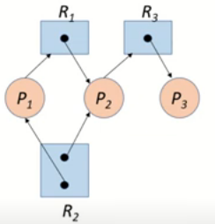
Multiple Instances of Resources in RAG.
Total: R1=1 R2 =2 R3=1
 | Allocation |  |  | Request |  |  | Available
 | R1 | R2 | R3 | R1 | R2 | R3 | R1 | R2 | R3
P1 | 0 | 1 | 0 | 1 | 0 | 0 | 0 | 0 | 0
P2 | 1 | 1 | 0 | 0 | 0 | 1
P3 | 0 | 0 | 1 | 0 | 0 | 0
1 2 1

Slide 26
Total: R1=1 R2 =2 R3=1
 | Allocation |  |  | Request |  |  | Available
 | R1 | R2 | R3 | R1 | R2 | R3 | R1 | R2 | R3
P1 | 0 | 1 | 0 | 1 | 0 | 0 | 0 | 0 | 0
P2 | 1 | 1 | 0 | 0 | 0 | 1
P3 | 0 | 0 | 1 | 0 | 0 | 0
( request <= Available)
P1, 1 0 0<= 0 0 0→ false.
P2, 0 0 1 <= 0 0 0 → false.
P3 , 0 0 0 < = 0 0 0 → P3 execute and release R3
avl=avl + Alloc = 0 0 0 + 0 0 1= 0 0 1
P1, 1 0 1 <= 0 0 1 → false.
P2, 0 0 1 <= 0 0 1 → true, P2 execute and release R1 & R2
avl=avl + Alloc =0 0 1+ 1 1 0 = 1 1 1
6. P1, 1 0 0 <= 1 1 1 → true, P1 execute and release R1
avl=avl + Alloc =1 1 1+ 0 1 0 = 1 2 1 ,so NO DEADLOCK here

Slide 27
Multiple Instances of Resources in RAG.
Total: R1=1 R2 =2 R3=1
 | Allocation |  |  | Request |  |  | Available
 | R1 | R2 | R3 | R1 | R2 | R3 | R1 | R2 | R3
P1 | 0 | 1 | 0 | 1 | 0 | 0 | 0 | 0 | 0
P2 | 1 | 1 | 0 | 0 | 0 | 1
P3 | 0 | 0 | 1 | 0 | 1 | 0
1 2 1

Slide 28
Total: R1=1 R2 =2 R3=1
 | Allocation |  |  | Request |  |  | Available
 | R1 | R2 | R3 | R1 | R2 | R3 | R1 | R2 | R3
P1 | 0 | 1 | 0 | 1 | 0 | 0 | 0 | 0 | 0
P2 | 1 | 1 | 0 | 0 | 0 | 1
P3 | 0 | 0 | 1 | 0 | 1 | 0
( request <= Available)
P1, 1 0 0<= 0 0 0→ false.
P2, 0 0 1 <= 0 0 0 → false
P3 , 0 0 0 < = 0 1 0 → false
so DEADLOCK here

Slide 29
Deadlock Avoidance
In deadlock avoidance, the request for any resource will be granted if the resulting state of the system doesn't cause deadlock in the system.
The state of the system will continuously be checked for safe and unsafe states.
To avoid deadlocks, the process must tell OS, the maximum number of resources a process can request to complete its execution.

Slide 30
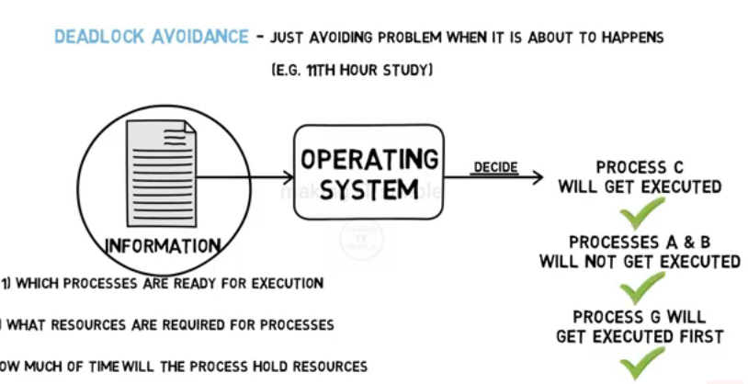

Slide 31
Techniques for Deadlock Avoidance
Banker’s Algorithm
the Banker’s Algorithm is a well-known method used for deadlock avoidance.

Slide 32
Banker Algorithm
The Banker's Algorithm developed by Edsger W. Dijkstra
banker algorithm used to avoid deadlock and allocate resources safely to each process.
It is also known as a deadlock detection algorithm.

Slide 33
Banker Algorithm
It only gives resources to a process if it’s sure that doing so won’t create a situation where no process can finish.
Before granting a request, the algorithm checks if, after giving the resources, the system will still be in a safe state—meaning at least one process can complete, which will free up more resources for others.
If it’s safe, the resources are given. If it’s not safe, the request is delayed to avoid deadlock.

Slide 34

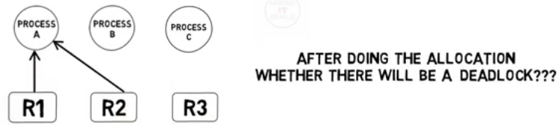
Why it is named “Banker's Algorithm”?
it is like the banking system to check whether a loan can be sanctioned to a person or not.
Suppose there are n number of account holders in a bank and the total sum of their money is S.(Rs.1000)
Let us assume that the bank has certain amount of money Y(Rs.500) as a liquid cash .
If a person applies for a loan then the bank first subtracts the loan amount from the total money that the bank has (Y) and if the remaining amount is greater than S then only the loan is sanctioned.
It is done because if all the account holders come to withdraw their money then the bank can easily do it.

Slide 35
Bankers algorithm in OS works similarly.
Each process within the system must provide all the important necessary details to the operating system like upcoming processes, requests for the resources, delays, etc.
Based on these details, OS decides whether to execute the process or keep it in the waiting state to avoid deadlocks in the system.
Thus, Bankers algorithm is sometimes also known as the Deadlock Detection Algorithm.

Slide 36
When working with a banker's algorithm, must know about three things:
How much each process can request for each resource in the system. It is denoted by the [MAX] request.
How much each process is currently holding each resource in a system. It is denoted by the [ALLOCATED] resource.
It represents the number of each resource currently available in the system. It is denoted by the [AVAILABLE] resource.

Slide 37
data structures terms applied in the banker's algorithm :
1. Available: This is an array that shows how many resources of each type are currently available in the system.
Example: If Available[1] = 3, means there are 3 instances of Resource 1 available.
2. Max: This is a matrix showing the maximum number of resources each process might need to complete its work.(Maximum Demand)
Example: Max[2][1] = 5 means that Process 2 might need up to 5 instances of Resource 1.

Slide 38
data structures terms applied in the banker's algorithm :
3. Allocation: This matrix shows how many resources have already been allocated to each process. (Current Allocation )
Example: Allocation[3][2] = 4 means that Process 3 is currently using 4 instances of Resource 2.
4. Need: This matrix shows how many more resources a process will need to finish its work.
Formula: Need[i][j] = Max[i][j] - Allocation[i][j]
Example: If Max[1][1] = 6 and Allocation[1][1] = 4, then Need[1][1] = 2, meaning Process 1 needs 2 more instances of Resource 1 to finish.

Slide 39
data structures terms applied in the banker's algorithm :
5. Finish:
This is a Boolean array (true/false) that tells whether a process has finished its execution.
Example: Finish[2] = true means Process 2 has completed and released its resources.

Slide 40
to control the processes and avoid deadlock in a system ,the Banker's Algorithm is of 2 types
safety algorithm &
resource request algorithm

Slide 41
Safety Algorithm - Banker Algorithm

Slide 42
Safety Algorithm steps:
It is a safety algorithm used to check whether or not a system is in a safe state or follows the safe sequence in a banker's algorithm:
Create two arrays: Work and Finish.
- Set Work = Available (resources available in the system).
- Set Finish[i] = false for all processes, meaning no process has finished. For i=0,1,….n-1
2. Find a Process:
Find an i such that
a) Finish[i] = false--------- process P[i] that hasn’t finished
b) Need[i] <= Work ------i.e., the system has enough resources to meet its remaining needs. And OS allocate resources to process

Slide 43
Safety Algorithm
3. Allocate Resources Temporarily:
- If such a process is found, then allocate its resources by setting
a) Work = Work + Allocation[i].
b) (Finish[i] = true)---- Mark this process as finished
4. Repeat:
- Repeat step 2 for all processes. If all processes can finish, the system is in a safe state. Otherwise, the system is not safe.
5. Check Safety:
If Finish[i] = true, for all processes then system is in a safe state.
If some processes are still Finish[i] = false, the system may go into deadlock.

Slide 44
Safe state algo
function isSafeState(Available[], Max[][], Allocation[][], Need[][MaxResouces], numProcesses, numResources):
# Step 1: Initialize Work and Finish
Work = Available
Finish = [False, False, ..., False] # One False for each process
# Step 2: Find a process that can be satisfied
while exists process P such that (Finish[P] == False and Need[P] <= Work):
# Step 3: Simulate resource allocation to process P
Work = Work + Allocation[P] # P finishes, releasing its resources
Finish[P] = True # Mark process P as finished
# Step 4: Check if all processes can finish
if Finish[i] == True for all i in range(numProcesses):
return True # System is in a safe state
else:
return False # System is not in a safe state

Slide 45
Example 1 Total available Resource A =10 ,B=5 &C=7
Given
Find this
 | Allocation |  |  | Max |  |  | Available |  |  | Need = Max-Allocation
 | A | B | C | A | B | C | A | B | C | A | B | C
P0 | 0 | 1 | 0 | 7 | 5 | 3 | 3 | 3 | 2 | 7 | 4 | 3
P1 | 2 | 0 | 0 | 3 | 2 | 2 |  |  |  | 1 | 2 | 2
P2 | 3 | 0 | 2 | 9 | 0 | 2 |  |  |  | 6 | 0 | 0
P3 | 2 | 1 | 1 | 2 | 2 | 2 |  |  |  | 0 | 1 | 1
P4 | 0 | 0 | 2 | 4 | 3 | 3 |  |  |  | 4 | 3 | 1
Total allocated : 7 2 5 check for safe state

Slide 46
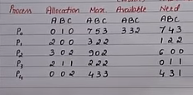
Work = 3 3 2
Finish =
Need[0] <= Work → work=work +allocation
For P0 , 7 4 3 <= 3 3 2, false
P1 , 1 2 3 <= 3 3 2, true → w=w + alloc
w = 3 3 2 + 2 0 0 = 5 3 2
P2 , 6 0 0 <= 5 3 2 ,false
P3 , 0 1 1<= 5 3 2, true
False
False
False
False
False
False
True
False
False
False

Slide 47
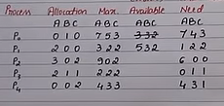
4. P3 , 0 1 1<= 5 3 2, true → w=w+alloc
w = 5 3 2 + 2 1 1 = 7 4 3
5. P4 , 4 3 1<= 7 4 3 , true → w=w+alloc
w = 7 4 3 + 0 0 2 = 7 4 5
False
True
True
False
False
False
True
False
True
True

Slide 48
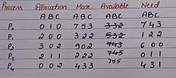
4. P0 , 7 4 3 <= 7 4 5 , true → w=w+alloc
w = 7 4 3 + 0 1 0 = 7 5 5
5. P2 , 6 0 0 <= 7 5 5 , true → w=w+alloc
w = 7 5 5 + 3 0 2 = 10 5 7
True
True
False
True
True
True
True
True
True
True
All are true so it is safe state means NO DEADLOCK and safe sequence is <P1,P3,P4,P0,P2>

Slide 49
Example 2
 | Allocation |  |  | Max |  |  | Available |  |  | Need = Max-Allocation
 | E | F | G | E | F | G | E | F | G | E | F | G
P0 | 1 | 0 | 1 | 4 | 3 | 1 | 3 | 3 | 0 | 3 | 3 | 0
P1 | 1 | 1 | 2 | 2 | 1 | 4 |  |  |  | 1 | 0 | 2
P2 | 1 | 0 | 3 | 1 | 3 | 3 |  |  |  | 0 | 3 | 0
P3 | 2 | 0 | 0 | 5 | 4 | 1 |  |  |  | 3 | 4 | 1
E=8 F=4 G=6 safe sequence is <P0,P2,P1,P3>
Safe state ----NO DEADLOCK

Slide 50
Resource Request - Banker Algorithm

Slide 51
Resource Request Algorithm
The Resource Request Algorithm is a part of the Banker's Algorithm used to determine if a system can allocate resources to a process without causing a deadlock.
If a process requests resources, the system checks whether this request can be safely granted.

Slide 52
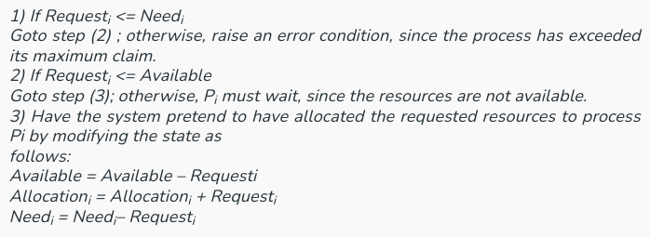
Steps in the Resource Request Algorithm:
Let Request_{i} be the request array for process P_{i}. Request_{i} [j] = k means process P_{i} wants k instances of resource type R_{j}.
When a request for resources is made by process P_{i}, the following actions are taken:

Slide 53
Example 1
 | Allocation |  |  | Max |  |  | Available
 | A | B | C | A | B | C | A | B | C
P1 | 0 | 1 | 0 | 7 | 5 | 3 | 3 | 3 | 2
P2 | 2 | 0 | 0 | 3 | 2 | 2
P3 | 3 | 0 | 2 | 9 | 0 | 2
P4 | 2 | 1 | 1 | 2 | 2 | 2
P5 | 0 | 0 | 2 | 4 | 3 | 3
Answer the following questions using the banker's algorithm:
What is the reference of the need matrix?
2. What will happen if process P₁ requests one additional instance of resource type A and two instances of resource type C?
3. Determine if the system is safe or not.

Slide 54
Answer:
 | Allocation |  |  | Max |  |  | Available |  |  | Need = Max-Allocation
 | A | B | C | A | B | C | A | B | C | A | B | C
P1 | 0 | 1 | 0 | 7 | 5 | 3 | 3 | 3 | 2 | 7 | 4 | 3
P2 | 2 | 0 | 0 | 3 | 2 | 2 |  |  |  | 1 | 2 | 2
P3 | 3 | 0 | 2 | 9 | 0 | 2 |  |  |  | 6 | 0 | 0
P4 | 2 | 1 | 1 | 2 | 2 | 2 |  |  |  | 0 | 1 | 1
P5 | 0 | 0 | 2 | 4 | 3 | 3 |  |  |  | 4 | 3 | 1
Context of the need matrix is as follows:
Need [i] = Max [i] - Allocation [i]
Need for P1: (7, 5, 3) - (0, 1, 0) = 7, 4, 3
Need for P2: (3, 2, 2) - (2, 0, 0) = 1, 2, 2
Need for P3: (9, 0, 2) - (3, 0, 2) = 6, 0, 0
Need for P4: (2, 2, 2) - (2, 1, 1) = 0, 1, 1
Need for P5: (4, 3, 3) - (0, 0, 2) = 4, 3, 1

Slide 55
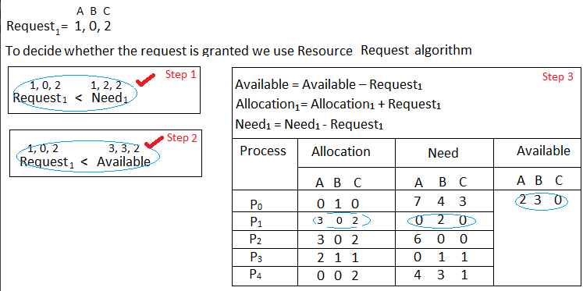
What will happen if process P₁ requests one additional instance of resource type A and two instances of resource type C?
→332 -102=230
→200 +102=302
→122 -102=020

Slide 56
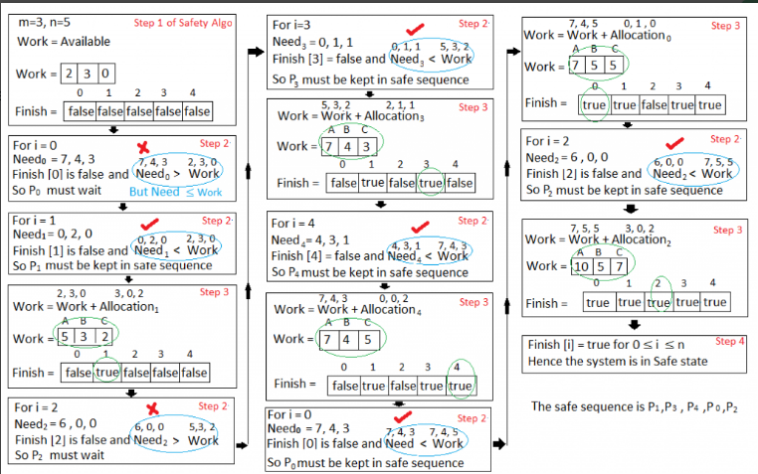

Slide 57
Deadlock Detection
Deadlock Detection and Recovery is the mechanism of detecting and resolving deadlocks in an operating system.
If deadlocks do occur, the operating system must detect and resolve them.
Detection methods help identify when this happens, and recovery techniques are used to resolve these issues and restore system functionality.

Slide 58
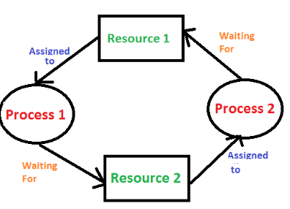
Deadlock Detection
1. If Resources Have a Single Instance
When each resource in the system has only one instance (i.e., each resource can be held by only one process at a time),
In this scenario, Resource Allocation Graph (RAG) can be used to detect deadlocks.
The presence of a cycle in the graph is indicate the deadlock.
In the above diagram, resource 1 and resource 2 have single instances. There is a cycle
R1 → P1 → R2 → P2. So, Deadlock is Confirmed.

Slide 59
2. If There are Multiple Instances of Resources:
When resources have multiple instances, cycle detection is not sufficient, and
we need a Deadlock Detection Algorithm that tracks how many instances of each resource type are available and how many are currently allocated. Ex : Banker's Algorithm or a Deadlock Detection Algorithm .

Slide 60
Deadlock Recovery

Slide 61
Deadlock Recovery
Deadlock recovery is a method used to handle deadlocks that have already occurred in a system.
In order to recover the system from deadlocks, either OS considers resources or processes.

Slide 62
Deadlock Recovery Techniques
1. Process Termination/kill process
This method involves terminating one or more processes to break the circular wait and resolve the deadlock.
There are two approaches to this:
a. Abort/kill All Deadlocked Processes : Terminate all processes that are involved in the deadlock.
b. Abort/kill One Process at a Time : Abort one process at a time, check if the deadlock is resolved, and repeat until the deadlock is broken.

Slide 63
Criteria for Process Selection for termination:
When choosing a process to terminate, the following factors may be considered:
Priority: Terminate the lowest-priority process.
Time: Terminate the process that has done the least amount of work.
Resources: Terminate the process holding the most resources.

Slide 64
Deadlock Recovery Techniques
2. Resource Preemption:
This method involves taking resources away from processes to resolve the deadlock.
It requires carefully selecting which resources can be preempted and from which process.
Step: a. Preempt the resource : The system chooses a process (or processes) from which resources will be preempted.
Step: b. Rollback : restoring the process to a state where it was before the resource was allocated.

